Slide 1
Planning Poker Simple Guideline
(Best Practice)
Sep. 10th ,2015
Delivery Competency, GADC

Slide 2
Agenda
Precondition
Story Point
Planning Poker
Planning Poker Procedure
Planning Poker Detail [1-6]
Other Attention Points
Timing of Utilization(Recommendation)
Notes:
Discussion Point:
1.How to implement the pilot PJ
2.Publish products as Agile model

Slide 3
Precondition
This material is defined by referring to definition of “Planning poker” from Wiki and some actual experiences , we added some important points which should be noticed in actual estimation into this material. So please know about Wiki definition as below before you start the learning of this guideline.
Wiki: http://en.wikipedia.org/wiki/Planning_poker
Notes:
Discussion Point:
1.How to implement the pilot PJ
2.Publish products as Agile model

Slide 4
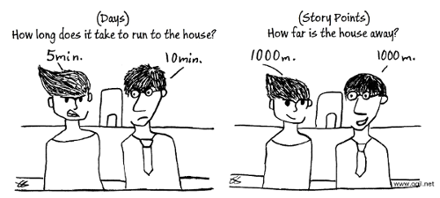

Story Point
What is Story
In agile software development, a story is a particular business or system need assigned to the development team, expressed in a few short sentences, ideally using non-technical language. Stories must be broken down into small enough components that they may be delivered in a single development iteration.
What is Story Point
A story point is a metric used in agile project management and development to determine (or estimate) the complexity of implementing a given story.
Please keep in mind Story Point is not ManDays or ManHours
Story point is more about the complexity, evaluates the size of the stories, not the effort of the stories. Story points don’t have direct ManDays or ManHours matches. Instead they have a range of hours that may change from team to team, project to project or time to time.
https://www.scrumalliance.org/community/spotlight/mike-cohn/june-2014/how-many-hours-is-a-story-point-worth
Notes:
Discussion Point:
1.How to implement the pilot PJ
2.Publish products as Agile model

Slide 5
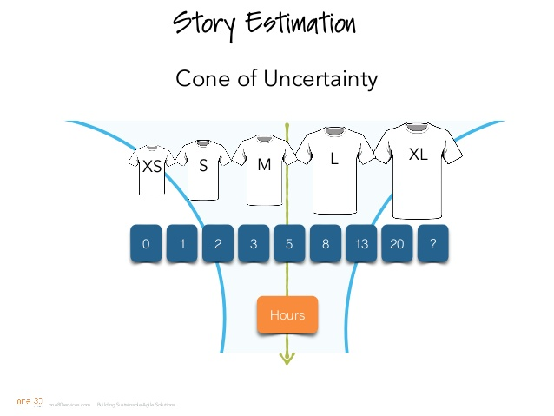
Story Point
How to estimate SP
Elements considered in assigning a story point include the complexity of the story, the number of unknown factors and the potential effort required to implement it.
Relative sizing is used to manage the inherent uncertainty in estimating requirements.
Story points are usually expressed according to a numerical range, such as an adaptation of a Fibonacci sequence, or according to a size range from X-S (extra-small) to X-L (extra large).
Different estimation techniques can be utilized according to the level of uncertainty.
This document will explain Planning poker with Fibonacci cards.
Notes:
Discussion Point:
1.How to implement the pilot PJ
2.Publish products as Agile model

Slide 6
Planning Poker
What is Planning poker
Planning poker, also called Scrum poker, is a consensus-based estimating technique. Agile teams around the world use Planning Poker to estimate their product backlogs. Planning poker is a variation of the Wideband Delphi method. It is most commonly used in agile software development, in particular in Scrum and Extreme Programming.
http://en.wikipedia.org/wiki/Planning_poker
Purpose of Planning poker (addition for standard)
・Unify the understand of all members by sharing each thinking due to ambiguous requirement.
・Ensure that everyone in development team can actively take part in estimation process and contribute his/her knowledge for estimation.
Timing of Utilization
As suggestion , it is more helpful if this method can be utilized at AP12 Solution Design and AP21 Requirement Development according to actual experiences. But projects can decide where this estimation method is applied.
Notes:
Discussion Point:
1.How to implement the pilot PJ
2.Publish products as Agile model

Slide 7
Planning Poker Procedure
Agile PMO | Representative of Customer | Dev. Team members
Organize estimation meeting
Provide business requirement and explain it to team members
Each members estimate and share result to PMO at the same time
The similar
Result?
Re-estimate
(No more than 3 times)
Clears open points and comments on peoples understanding
N
Boundaries explain why?
Y
Comment/
Confirmation
Make a acceptable estimation result
No | Role | Responsibility in Estimation
1 | Dev. Team members (Expert) | ・Estimate and share result to PMO ・Improve the estimation value by others’ suggest
2 | Agile PMO | ・Organize estimation meeting ・Control the meeting schedule and topic ・Make a acceptable estimation result
3 | Representative of Customer | ・Provide business requirement and explain it to team members ・Comment/Confirm for the estimation result
Notes:
Discussion Point:
1.How to implement the pilot PJ
2.Publish products as Agile model

Slide 8
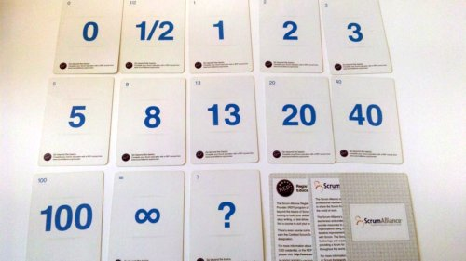
Planning Poker Detail [1/6]
1. Distribute planning poker card to estimation members.
Red part is enough for estimation
※ a kind of commercially available decks.
・ About symbol “?” and “∞”
a. No estimation result : “?”
b. Very hard : “∞”
Notes:
Discussion Point:
1.How to implement the pilot PJ
2.Publish products as Agile model

Slide 9
Planning Poker Detail [2/6]
2. Decide the standard backlog.
Standard backlog: A reference story to be used in sizing other stories. Can be selected among achieved stories as well.
Backlog A
Backlog B
e.g. Standard backlog = 2 SP
Backlog C
Backlog D
[Selection Rules]
・All members can understand
・Not very complicated
・Standard backlog estimation is not mandatory.
・Clear the estimation scope(Coding to UT? RD to UAT? …) before starting estimation.
・Don’t decide who is PIC.
Notes:
Discussion Point:
1.How to implement the pilot PJ
2.Publish products as Agile model

Slide 10
Planning Poker Detail [3/6]
3. RoC explain other backlog, then team members show the card simultaneously.
Backlog A
Backlog B
e.g. Standard backlog = 2 SP
This one?
Backlog C
Backlog D
５
５
８
？
・Start from high priority backlog.
・Need to show card simultaneously.
Notes:
Discussion Point:
1.How to implement the pilot PJ
2.Publish products as Agile model

Slide 11
Planning Poker Detail [4/6]
4. Need to discuss when they can not unify the understanding. PO should clarify open points and misunderstandings.
５
８
Have similar case ,that is “5” SP
Hesitate “5” or “8”, and select the bigger one
５
？
No experience
The same as pre backlog
・Succinct and short time discussion.
Notes:
Discussion Point:
1.How to implement the pilot PJ
2.Publish products as Agile model

Slide 12
Planning Poker Detail [5/6]
5. Show the card again, in order to unify the understanding.
1st
５
５
８
？
2nd
５
５
５
？
Final result is “5”
Notes:
Discussion Point:
1.How to implement the pilot PJ
2.Publish products as Agile model

Slide 13
Planning Poker Detail [6/6]
6. If it is difficult to unify the understanding after 3 times. To select the following as final result.
・the bigger one.
・the average.
※In this situation , it means no enough knowledge to team members, maybe it is not correct estimation result , so as soon as possible to start project rather than discussion.
Notes:
Discussion Point:
1.How to implement the pilot PJ
2.Publish products as Agile model

Slide 14
Other Attention Points
・Need to note the 0.0 Hours tasks which probably can spend some time as well like sending e-mail to someone for sharing information.
・ Need to find the balance between dev. and test because test can not start at the beginning of project.
・Get the agreement about the final result from every member.
・Test ratio should be thought before estimation, but it should be different by time to time or PJ to PJ. Depending on some experiences, it can be 20%-60%(Only Reference).
Notes:
Discussion Point:
1.How to implement the pilot PJ
2.Publish products as Agile model

Slide 15
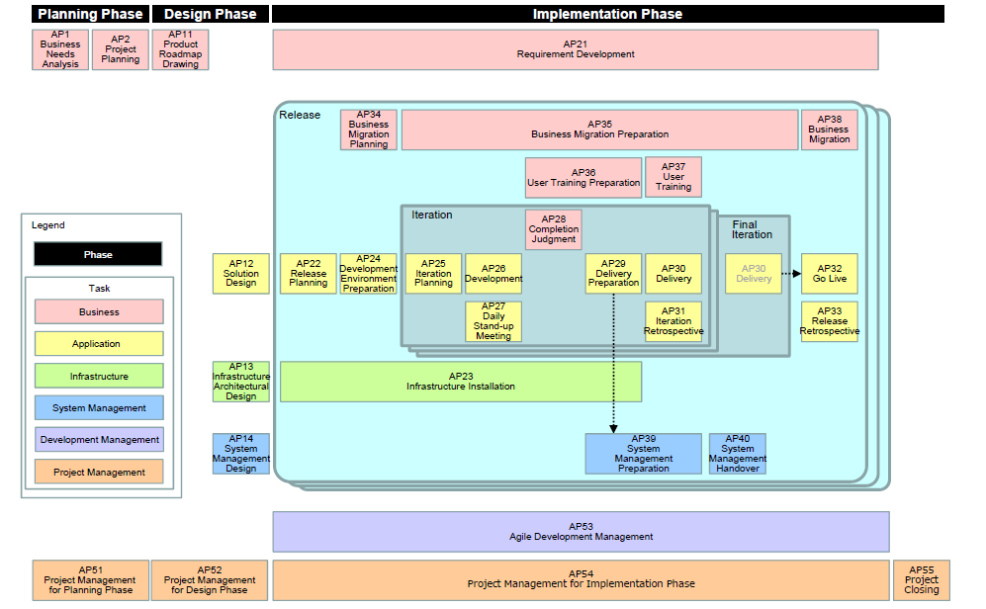
Timing of Utilization(Recommendation)
GCM
Recommend that “Planning Poker” can be utilized in the following two tasks.
1.AP21:According to GCM definition. In this task, Representative of Customer will pick up high-level functions (Epic) and estimate volume of User Story with Development Team. It has the same scene as “Planning Poker”. So it is suitable to “Planning Poker”.
2.AP12:Although no estimation definition about this task in GCM, but as actual implementation status , development team still need to estimate with Representative of Customer. So it is suitable to “Planning Poker”.
Supplement
1.AP22:It is difficult to produce more detailed estimation result than AP21, it’s meaningless to estimate as ”Planning Poker”.
2.AP25:Only development team take charge of this task. They can decide the estimation method.
Notes:
Discussion Point:
1.How to implement the pilot PJ
2.Publish products as Agile model

Slide 16
EOF

Slide 17
Appendix
Notes:
Discussion Point:
1.How to implement the pilot PJ
2.Publish products as Agile model

Slide 18
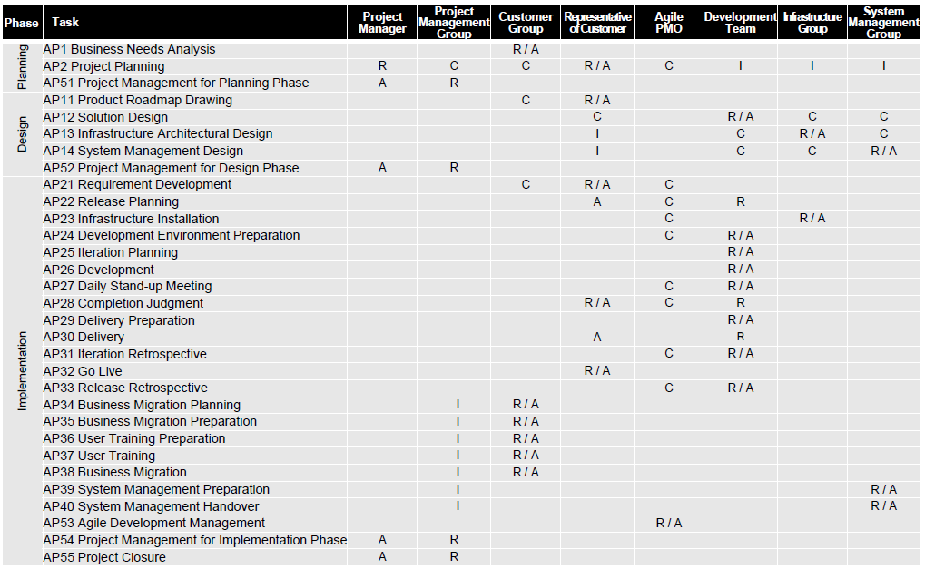
RACI Chart

Slide 19
Utilization Position of Planning Poker
Planning Phase
Design Phase
Implementation Phase
Respective of Customer
AP2
AP11
AP21
• Pick up high-level functions (Epic) from Product Roadmap with stakeholders.
• Estimate the business values of Epic and
determine the priority of Epic.
• Breakdown Epic into User Story with stakeholders.
• Estimate volume of User Story with Development Team.(Planning Poker)
• Determine the priority of User Story while considering the result of estimation.
• Define the acceptance criteria of each User Story.
• Define Personas.
• Define Epics.
• Set milestones for systemization.
• Define the criteria necessary to guarantee system quality.
AP12
AP22
AP25
• Analyze and understand the User Story which is the target of relevant Iteration (Confirm the unclear points with Representative of Customer).
• Clarify task for implementation of User Story.
• Estimate man-hour of each task, determine order of task, and prepare Iteration Backlog.
• Get agreement of Iteration Backlog from Representative of Customer.
Development Team
(GADC?)
• Confirm restrictions (delivery date, cost, etc.) on system requirements and system construction.
• Examine application policy, data policy and technology policy referring to the road map of Enterprise Architecture (Application Architecture/Data Architecture/Technology Architecture).
Representative of Customer:
• Explain User Story which is target of implementation to Development Team using Product Backlog.
Development Team:
• Understand User Story and confirm the unclear points with Representative of Customer.
• Estimate the development man-hour
• Determine the unit period of Iteration.
• Allocate User Story to each box of Iteration based on their priorities.
• Confirm that Release Plan matches with the release date. Push the items which are not matched to the release date to the subsequent requirements to be implemented.
Agile Development Group:
• Agree on the Release Plan.
I think “restrictions” also need to be explained by RoC.
Although here is not mentioned about estimation. but actually we need to estimate when we get this request.
Depending on above two points, AP12 also can utilize “Planning Poker”.
Need to discuss with GCM for removing this.
GCM Definition

Slide 20


Planning Poker Procedure
Estimation Meeting
Dev. team
Explain Backlog
Representative of Customer
Member
Comment/
Confirmation
Member
Estimation Result
The similar
result?
Y
Final result
Final Estimation Result
Member
N
Control
Member
Re-estimate
(No more than 3 times)
Agile PMO
No | Role | Responsibility in Estimation
1 | Dev. Team members (Expert) | ・Estimate and share result to PMO ・Improve the estimation value by others’ suggest
2 | Agile PMO | ・Organize estimation meeting ・Control the meeting schedule and topic ・Make a acceptable estimation result
3 | Representative of Customer | ・Provide business requirement and explain it to team members ・Share the suggest for the estimation result
Notes:
Discussion Point:
1.How to implement the pilot PJ
2.Publish products as Agile model

